Slide 1
Hardware Hackathon
DCU Innovation Campus – 1st November 2014
Galileo Workshop

Slide 2

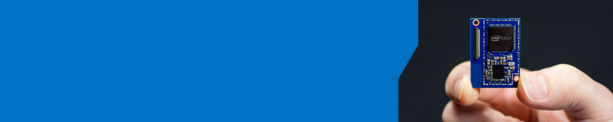
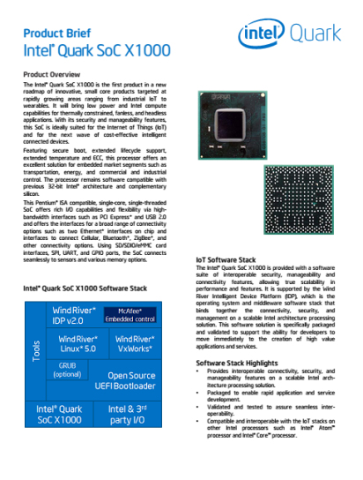
What Will You Make?
Intel® Galileo – Easily try out technology solution ideas
Intel® Edison - Create wearables and other products for the Internet of Things
Intel Facts
Global headquarters: Santa Clara, California
107,600 employees worldwide (at end of 2013)
55 percent of employees reside in the U.S.
2013 net revenue ~ R560 billion
Intel’s vision: This decade we will create and extend computing technology to connect and enrich the life of every person on earth

Slide 3
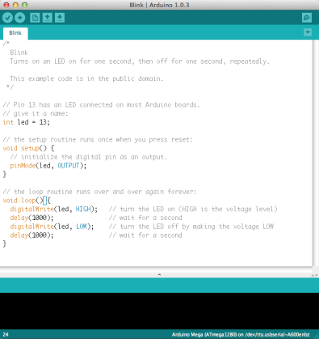
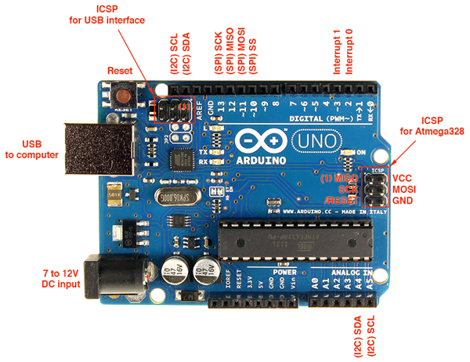
What is Arduino?
An open-source hardware and software platform for building electronics projects
A physical programmable circuit board (often referred to as a microcontroller)
A piece of software, or IDE (Integrated Development Environment) that runs on your computer, used to write and upload computer code to the physical board (supports Mac/Windows/Linux)

Slide 4
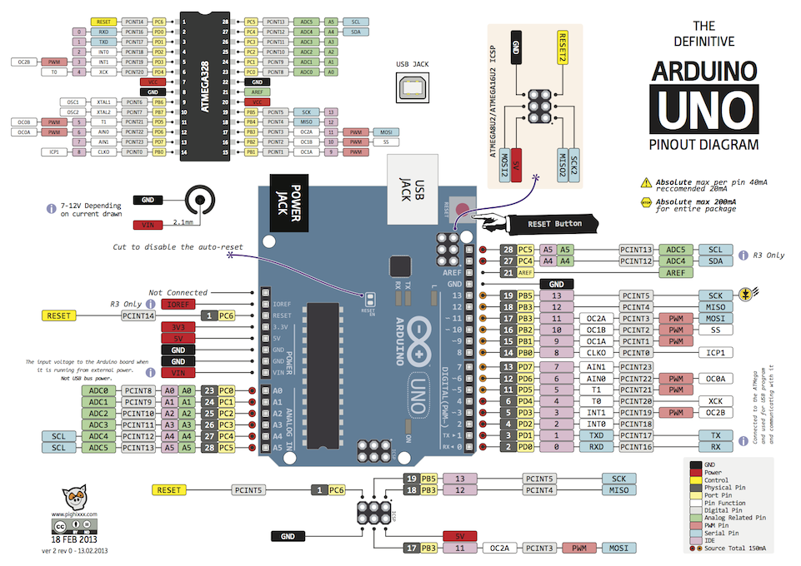

Slide 5
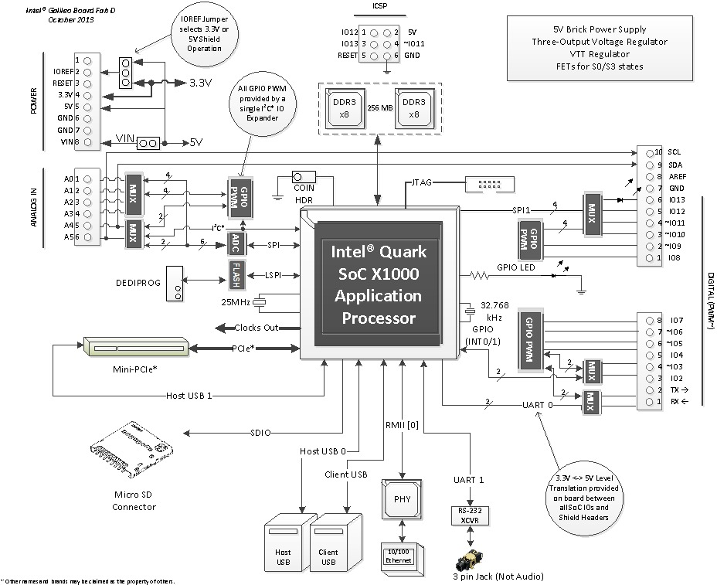

Slide 6
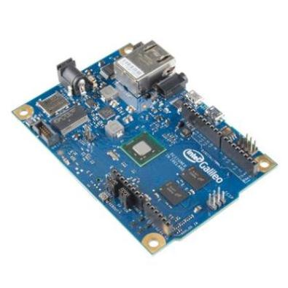
10 Great things about Galileo
Shield Compatibility WiFi/Ethernet Library Compatibility
Familiar Arduino IDE Real Time Clock
MicroSD Support USB Host Port
Serial Connectivity Linux on Board
Works with PCI Express Mini Cards TWI/I2C, SPI Support
Source Makezine: http://makezine.com/2013/10/03/10-great-intel-galileo-features/

Slide 7
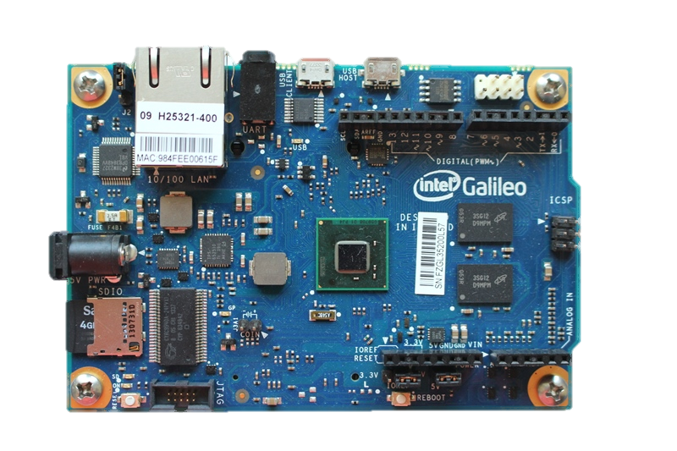
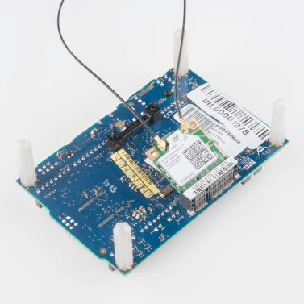
Galileo Board Overview
Processor (Quark X1000)
RAM (256 MB DRAM)
Flash Memory
32GB Micro-SD Card Slot
6-pin analog input header
8-pin power header
8-pin digital I/O
10-pin digital I/O
USB Client Port
USB Host Port
Serial Port (RS-232)
Power Input (5V)
Ethernet Port
Mini PCI Express Slot
Clock Battery Power
Reboot Button
Reset Button
JTAG Header
11
9
10
13
3
8
7
12
1
2
4
15
6
5
18
17
16

Slide 8
Galileo - Arduino Hardware Compatibility
Standard Arduino UNO connectors:
Supports 3.3V and 5V shields
8-pin power header (3.3V, 5V, GND, Reset, etc.)
6-pin analog input header (A0-A6)
8-pin digital I/O header (D0-D7), which includes UART on pins 0/1, PWM on pins 3, 5, and 6
10-pin digital I/O header (D8-SCL), which includes I²C pins and PWM on pins 9, 10, and 11
2x3-pin ICSP header breaks out SPI pins

Slide 9
Galileo - Capabilities beyond Arduino UNO
Hardware
400MHz Quark SoC
512KB SRAM
256MB DRAM
8 MByte Flash
Micro-SD slot
Mini-PCI Express slot
100Mb Ethernet port
USB Host port
USB Client Port
Software
Linux OS on Board
Intel SW Tools
IoTDevKit
JTAG debugger (OpenOCD)
Intel Software Tools (ISS)

Slide 10
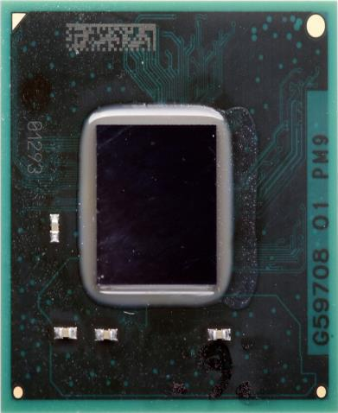
Intel® Quark SoC X1000 - Pentium compatible ISA
Processor Core
Single Quark CPU Core, Single Thread
32 bit, x86, @ 400MHz
Industry Standard Software Support
Standard Compiler Support (ICC/GCC)
Pentium ISA Compatibility (.586)
Runs unmodified Linux* Kernels (v3.8)
Yocto based distribution
Validated w WR IDP 2.0 (Linux & VxWorks)
Open Source UEFI EDK II
GRUB boot loader support
Open OCD Debugging support
Compliant with PCIe, USB, ACPI standards
Processor UnCore
DDR3 memory controller
Up to 2GB @ 800MTs
ECC-On-Chip (X1010/X1020)
Embedded 512KB SRAM
Legacy Block
PC compatible IO ports, APICs, etc.
20MHz Legacy SPI for boot code
Low cost 5-pin JTAG Port
Open Hardware Architecture
AMBA Bus fabric = Flexible Silicon IP
Physical
Package size 15x15mm
393 Pin, FC BGA bare die
0.593 Ball Pitch
Enables FR4 SFF Board
Security
Secure Boot Technology Option (X1020)
Supervisory Mode Execution Protection
Secure Recovery for UEFI FW
Secure Remote Upgrade w/ WR IDP 2.0
Industry Standard I/O Hardware
2 - x1 PCIe Gen 2**
2 - 10/100Mb Ethernet* MACs
2 - USB2 host ports (EHCI, OHCI)
2 - HS UART controller
2 – 50MHz SPI ports for peripherals
1 – USB2 HS Device port
1 - SD/SDIO/eMMC interface
1 – I2C/GPIO Host controller
16 - GPIOs w/ programmable interrupts
Thermals
TDP: 2W (VR dependent)
Tj = 110°C
Commercial Temp (WW46)
Ext temp -40 to +85°C (Q1’14)
Programmable Thermal sensor
Electricals:
Single xtal for internal/external clocks
Enabled Single std external VR solution
*Other names and brands may be claimed as the property of others.
** PCIe Gen1 speed to save power

Slide 11
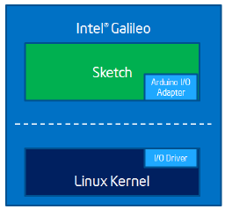
Arduino Software Compatibility
Familiar Arduino IDE with example sketches
Load Sketch from PC to Galileo

Slide 12
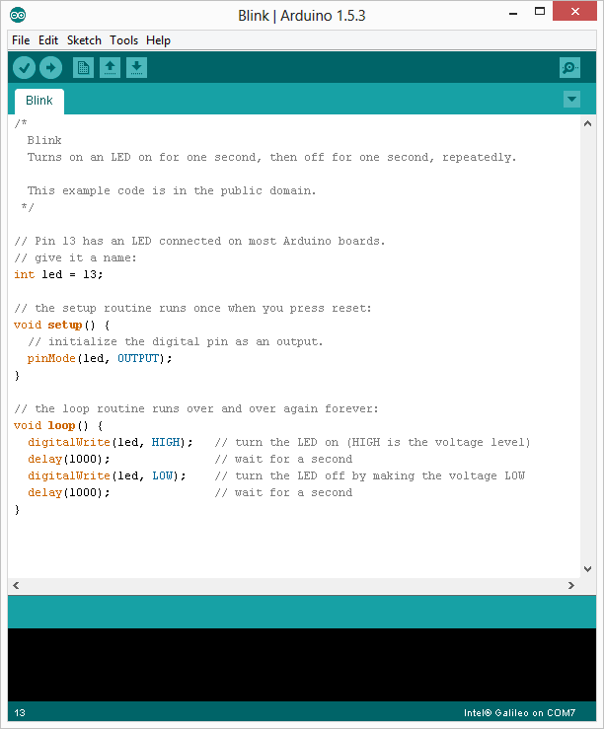
Sketch Overview
Comment Block
Comment
Global Variable
Code executed once on initial load
Code Loop ran continuously

Slide 13
Software Stack

Slide 14
Arduino Shields
There are hundreds of shields available from dozens of suppliers
GSM/Wifi/Bluetooth Ethernet/GPS
Battery/Solar RS232/RS485
RFID/Xbee/NFC SD/EEPROM
Midi/WAV/MP3 Camera/Video/Home
Sensors/LCDs Robotics/Fun/Actuators
shieldlist.org
adafruit.com
cooking-hacks.com
sparkfun.com
store.arduino.cc
cutidigi.com
etc

Slide 15
Reboot and Reset Button Differences
Reset Button
Restart the Arduino sketch running on the Galileo. Includes re-executing the code defined within the Setup section
Acts much more like the reset button you may be used to
Reboot Button
Will reboot the entire Galileo - Linux included
Boot time is about 30 seconds, so don’t press this accidentally!

Slide 16
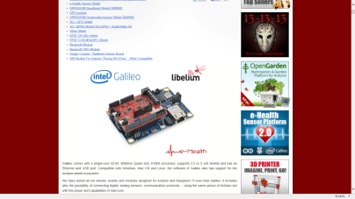
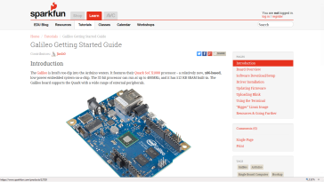
Galileo Support
Galileo Support
http://www.intel.com/content/www/us/en/do-it-yourself/galileo-maker-quark-board.html
Galileo support site: http://www.intel.com/support/galileo/
How to videos: http://www.intel.com/support/galileo/howtovideos.htm
Intel Maker community: https://communities.intel.com/community/makers
Documents: https://communities.intel.com/community/makers/documentation/galileodocuments
Data sheet: https://communities.intel.com/docs/DOC-21835
Board User Guide: https://communities.intel.com/docs/DOC-22475
Drivers: https://communities.intel.com/docs/DOC-22226
There are many Galileo communities e.g.
Sparkfun getting started guide: https://learn.sparkfun.com/tutorials/galileo-getting-started-guide
Using Galileo with Arduino shields: http://www.cooking-hacks.com/documentation/tutorials/intel-galileo-tutorial-using-arduino-and-raspberry-pi-shields-modules-boards

Slide 17
Lets Get Started!

